Slide 1
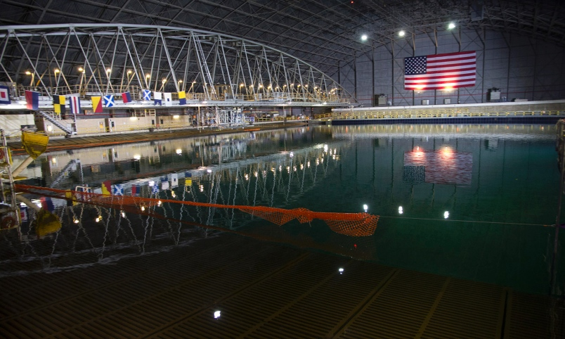
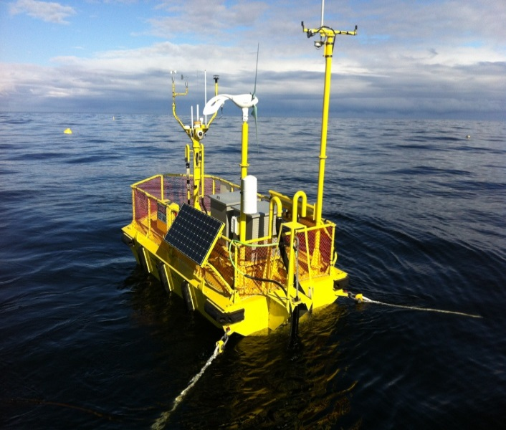
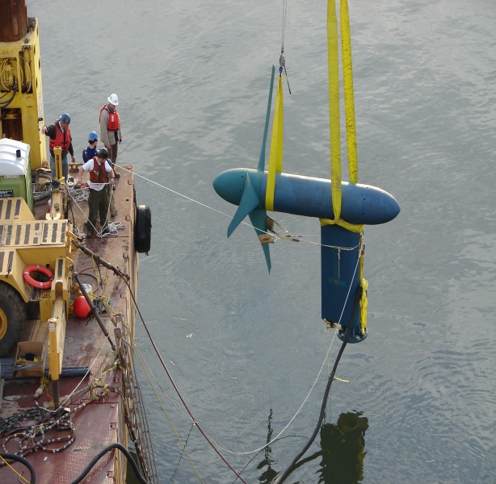
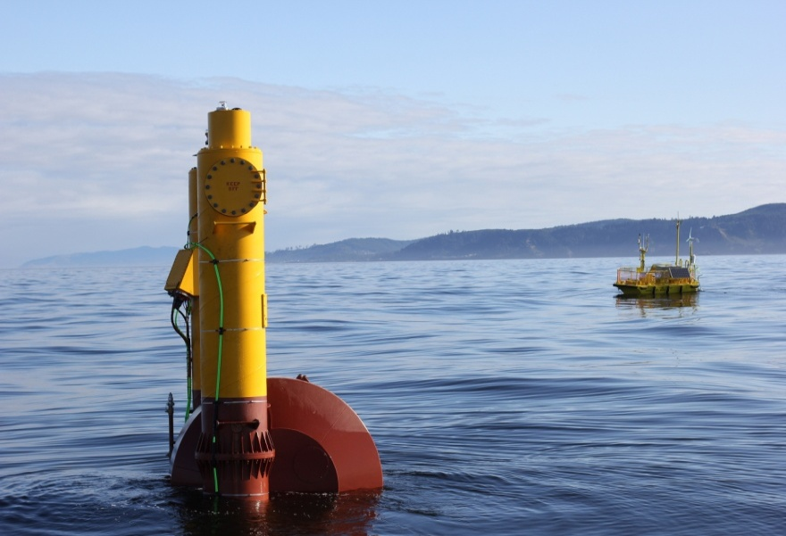
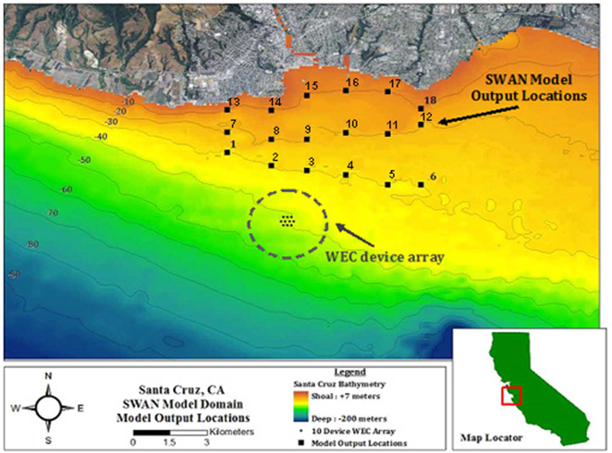
Data Input Process Guide for MHK LCOE Calculations
Alison LaBonte
MHK Technology Development Lead
Voice over by Scott Jenne (NREL)
Multi Disciplinary Research Engineer
June 15, 2015

Slide 2

Purpose
This PowerPoint presentation is intended to serve as a guide for funding recipients when submitting cost of energy data. The following slides describe the inputs into the Levelized Cost of Energy (LCOE) equation. The presentation will also serve as a guide on what assumptions should be made when calculating LCOE, as well as methods to modify the framework so that the unique aspects of each project are captured appropriately.
Outline

Slide 3
Table of Contents
LCOE Overview
Fixed Charge Rate Calculations
Annual Energy Production
Required AEP Deliverables
Wave
Current
Reference Resource
Example data set
Capital and Operational Expenditures
Filling out the System Cost Breakdown Structure
Final LCOE Calculation
Checklists
Wave Checklist
Current Checklist
Additional Resources

Slide 4
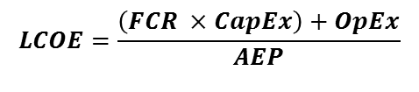
Required LCOE Inputs
Levelized Cost of Energy (LCOE)
Fixed Charge Rate (FCR)
Standardized for DOE recipients
Annual Energy Production (AEP)
Estimated energy production at reference location given sea state distribution.
Capital Expenses (CapEx: Year 0 Costs)
Operational Expenses (OpEx: Year 1-n costs)
$$LCOE=\frac{\left(FCR ×CapEx\right)+OpEx}{AEP}$$
Outline

Slide 5
Required LCOE Inputs
LCOE – Levelized Cost of Electricity
Fixed Charge Rate (FCR)
Standardized for DOE recipients
Annual Energy Production (AEP)
Estimated energy production at reference location given sea state distribution.
Capital Expenses (CapEx: Year 0 Costs)
Operational Expenses (OpEx: Year 1-n costs)
Outline

Slide 6
Fixed Charge Rate
Fixed Charge Rate (FCR) is the fraction of capital expenditures necessary to recover project costs and meet investor revenue requirements.
Using defined variables below the Fixed Charge Rate (FCR) equates to 10.8%. This value should be used for all calculations.
More detail can be found on MHK LCOE OpenEI page.
Outline

Slide 7
Required LCOE Inputs
LCOE – Levelized Cost of Electricity
Fixed Charge Rate (FCR)
Standardized for DOE recipients
Annual Energy Production (AEP)
Estimated energy production at reference location given sea state distribution.
Capital Expenses (CapEx: Year 0 Costs)
Operational Expenses (OpEx: Year 1-n costs)
Outline

Slide 8
Required AEP Deliverables (Wave)
Time-domain numerical model
Simulations need to be performed based on the statistical dataset provided. (lcoe_reference_resource.xlsx)
Developers must calculate performance in the reference resource mapping mechanical to electrical power. The 2 power matrices should be developed as follows:
The technology developer shall produce a time series for mechanical and electrical power using the reference site scatter diagram.
The length of the time series must be at least 200 energy periods (200 Te), with a recommended time step of 0.01Te.
Bin sizes should follow the bin size of the scatter diagram, and be a maximum of 0.5m (significant wave height) by 1 second (energy period).
All additional modeling parameters (e.g., viscous damping coefficients, mooring configuration, etc.) will need to be addressed and documented.
Additional variables may need to be considered such as mean wave direction.
If applicable, shallow water reductions must be included. an averaged 10% AEP loss can be assumed (Folley and Whittaker, 2009) in lieu of supporting documentation.
All above steps are necessary for any additional “design” resources that the developer chooses to analyze. Regardless of the design resource developers MUST evaluate the device in the reference resource.
Array losses (for the reporting cases at array scale) must be estimated and reported.
Results must be provided along with a narrative of the description, and results of the numerical model.
Any experimental tests performed (Tank Testing, Open Ocean, etc.) should refer to the applicable MHK Content Model on the MHK Data Repository OpenEI page.
MHK Content Models
Outline

Slide 9
Required AEP Deliverables (Current)
Developers should prepare a representation of device performance in the form of a mechanical and electrical power curve.
Power should be represented as average kW in 0.1 m/s bins
The power curve must include cut-in and cut-out speeds
A similar curve should be prepared depicting Cp vs Flow
A velocity distribution (see reference resource) should be multiplied by the above power curve.
AEP is then estimated using the annual average
Must include availability, and transmission loss assumptions.
Ideally the power curve will be produced from a full-scale in-water deployment data set in accordance with (IEC 2012b).
If full-scale development data is unavailable (such as in the case of low TRL projects) the developer must provide a narrative description of the model architecture used to estimate power output, and power coefficient (Cp)
Any experimental tests performed (Tank Testing, Open Ocean, etc.) should refer to the applicable MHK Content Model on the MHK Data Repository OpenEI page.
MHK Content Models
Outline

Slide 10
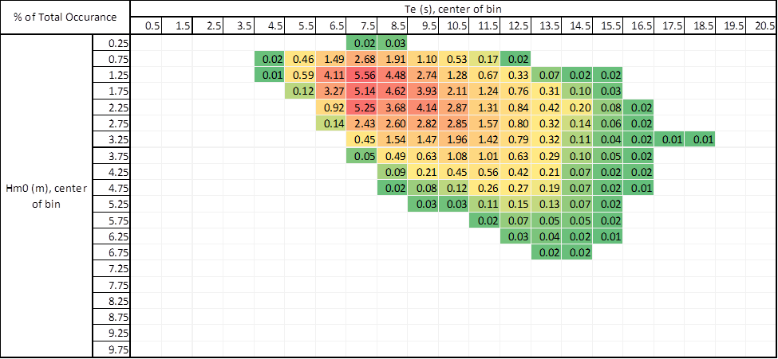
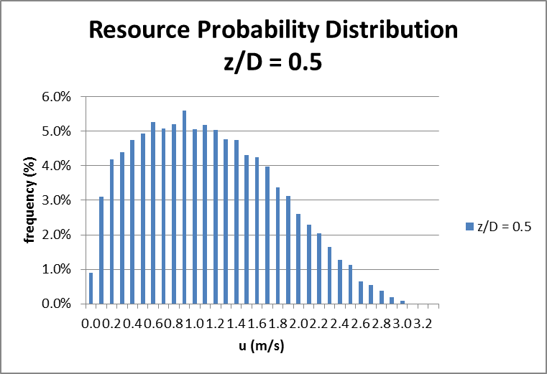
Reference Resource
Reference resources (1 tidal, 1 wave) has been provided
Normalize assumptions related to deployment location and resource intensity to produce comparable energy generation calculations. Link to Reference Resource
Wave Energy – Resource is represented as a scatter diagram of resource off the coast of Humboldt Bay, CA.
Tidal Energy – Resource is represents current speeds at Puget Sound’s Admiralty Inlet.
Additional resources may be included, in addition to the supplied resource.
Wave Energy Resource Example
Tidal Energy Resource Example
Outline

Slide 11
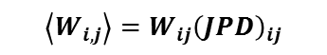
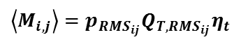
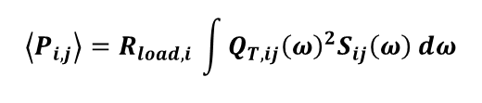
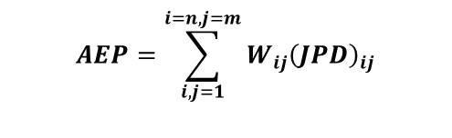
Example AEP Case (RM6)
The Methodology used to calculate energy production needs to be well documented.
For the DOE Reference Model 6 (RM6) example case a numerical analysis was performed to estimate the response of an Oscillating Water Column (OWC) to random waves.
The Average Pneumatic Power absorbed at each sea state (i=T_{p}, j=H_{s}) was calculated using :
The Average Mechanical Power at each sea state was calculated using:
The Average Electrical Power was calculated at each sea state using:
Finally the Average Annual Energy Production (AEP) was calculated using:
JPD = Joint Probability Distribution
For a more details regarding this analysis see Bull 2014 and Smith et al. 2014
$$\left\langle P_{i,j}\right\rangle =R_{load,i }\int{Q_{T,ij}{\left(ω\right)}^{2}S_{ij}\left(ω\right)}dω$$
$$\left\langle M_{i,j}\right\rangle =p_{{RMS}_{ij}}Q_{{T,RMS}_{ij}}η_{t}$$
$$\left\langle W_{i,j}\right\rangle =W_{ij}{\left(JPD\right)}_{ij}$$
$$AEP=\sum_{i,j=1}^{i=n, j=m}{W_{ij}{\left(JPD\right)}_{ij}}$$
Outline

Slide 12
Example AEP Case (RM6)
DOE Reference Model 6 : Oscillating Water Column
The most current reference resource is available for download on OpenEI Water Power Forum page under Files.
It can also be downloaded directly via this link
 |  |  | Peak Period, Tp [sec]
 |  |  | 4.7 | 5.7 | 6.7 | 7.7 | 8.7 | 9.7 | 10.7 | 11.7 | 12.7 | 13.7 | 14.7 | 15.7 | 16.7 | 17.7 | 18.7
1 | Significant Wave Height, Hs [m] | 0.25 | 0.000 | 0.000 | 0.000 | 0.000 | 0.000 | 0.000 | 0.000 | 0.000 | 0.000 | 0.000 | 0.000 | 0.000 | 0.000 | 0.000 | 0.000
2 |  | 0.75 | 0.001 | 0.004 | 0.011 | 0.011 | 0.013 | 0.004 | 0.006 | 0.003 | 0.002 | 0.002 | 0.003 | 0.004 | 0.005 | 0.002 | 0.000
3 |  | 1.25 | 0.001 | 0.010 | 0.028 | 0.024 | 0.046 | 0.018 | 0.022 | 0.011 | 0.009 | 0.007 | 0.005 | 0.004 | 0.004 | 0.002 | 0.000
4 |  | 1.75 | 0.000 | 0.002 | 0.025 | 0.027 | 0.036 | 0.021 | 0.035 | 0.019 | 0.014 | 0.012 | 0.010 | 0.005 | 0.005 | 0.003 | 0.000
5 |  | 2.25 | 0.000 | 0.000 | 0.006 | 0.023 | 0.036 | 0.017 | 0.033 | 0.024 | 0.019 | 0.015 | 0.010 | 0.006 | 0.005 | 0.003 | 0.000
6 |  | 2.75 | 0.000 | 0.000 | 0.002 | 0.009 | 0.027 | 0.010 | 0.022 | 0.020 | 0.015 | 0.013 | 0.009 | 0.005 | 0.005 | 0.003 | 0.000
7 |  | 3.25 | 0.000 | 0.000 | 0.000 | 0.002 | 0.011 | 0.007 | 0.012 | 0.013 | 0.012 | 0.011 | 0.008 | 0.005 | 0.004 | 0.002 | 0.000
8 |  | 3.75 | 0.000 | 0.000 | 0.000 | 0.000 | 0.003 | 0.003 | 0.005 | 0.007 | 0.007 | 0.007 | 0.006 | 0.003 | 0.003 | 0.001 | 0.000
9 |  | 4.25 | 0.000 | 0.000 | 0.000 | 0.000 | 0.001 | 0.001 | 0.002 | 0.003 | 0.003 | 0.004 | 0.004 | 0.002 | 0.002 | 0.001 | 0.000
10 |  | 4.75 | 0.000 | 0.000 | 0.000 | 0.000 | 0.000 | 0.000 | 0.001 | 0.001 | 0.001 | 0.002 | 0.002 | 0.001 | 0.002 | 0.001 | 0.000
11 |  | 5.25 | 0.000 | 0.000 | 0.000 | 0.000 | 0.000 | 0.000 | 0.000 | 0.000 | 0.000 | 0.001 | 0.001 | 0.001 | 0.001 | 0.001 | 0.000
 |  |  | 4.0 | 4.9 | 5.7 | 6.6 | 7.5 | 8.3 | 9.2 | 10.0 | 10.9 | 11.7 | 12.6 | 13.5 | 14.3 | 15.2 | 16.0
 |  |  | Energy Period, Te [sec] 2π(m₋₁/m₀)
Wave Resource Distribution
Outline

Slide 13
Example AEP Case (RM6)
Pneumatic Power (Potential energy in air column) calculated at each sea state which is then converted into Mechanical Power (Turbine Output)
Pneumatic Power
Mechanical Power
This step accounts for the wave to device interaction, it is expected that each device will have it’s own interaction.
In some instances mechanical power may be the first interaction (i.e relative motion of point absorber, oscillating flap, etc.)
If that is the case an additional step may be required. In the instance of a hydraulic drivetrain hydraulic power should be calculated at each sea state.
Outline

Slide 14
Example AEP Case (RM6)
A final calculation to electrical power is required. This will include any power electronic efficiencies (i.e generator, frequency converter, etc.)
Mechanical Power
Electrical Power
As mentioned in the previous slide there may be an additional step in between mechanical and electrical power, such as hydraulic power.
Outline

Slide 15
Example AEP Case (RM6)
Electrical Power output is then fed back into the wave resource distribution to estimate Annual Energy Production.
Multiply the power at each sea state, by the probability of occurrence at each sea state and sum table to estimate Annual Energy Production.
Distribution
Electrical Power
Outline

Slide 16
Example AEP Case (RM6)
Power x Frequency at each sea state
Summing these values results in an average power output of 103.2 kW
Multiplying this by 8,760 hours/year gives an AEP of 904 MWh/year
*Note that all system losses (i.e., transmission, array losses) must be accounted for including justifications for assumptions.
Outline

Slide 17
Example AEP Case (RM6) - Recap
Use given resource probability matrix (Reference Resource Spreadsheet)
Deliver quantities for “critical” efficiency steps
Device interaction with wave (i.e., pneumatic, mechanical)
Interaction with mechanical system and drivetrain (i.e., hydraulic, gearbox)
Conversion to electrical power
More depending on device
Use electrical power and resource probability to deliver quantitative average power output
Calculate Annual Energy Production
Include and provide quantities assumed for all system losses (i.e., transmission, array, generator rating, survival conditions, etc.)
Outline

Slide 18
Required LCOE Inputs
LCOE – Levelized Cost of Electricity
Fixed Charge Rate (FCR)
Standardized for DOE recipients
Annual Energy Production (AEP)
Estimated energy production at reference location given sea state distribution.
Capital Expenses (CapEx: Year 0 Costs)
Operational Expenses (OpEx: Year 1-n costs)
Outline

Slide 19
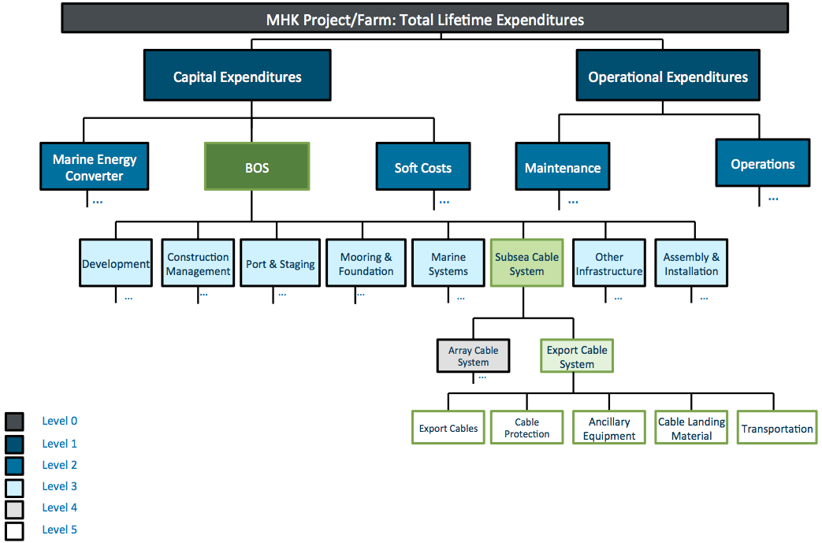
What is the SCBS?
System Cost Breakdown Structure (SCBS)
Organizes Capital Expenses (year 0) and Operational Expenses (years 1 – n)
Multiple levels of detail
Gives DOE MHK program insight into critical areas.
Data gaps
Potential research topics
Benchmarks
Outline

Slide 20
Filling out the SCBS
Include deepest level available
This is especially critical in instances where funding is allocated towards a particular area of research
Example: if a FOA is awarded to advance hydraulic PTO designs, the SCBS should include a deep level of costs for hydraulic system and associated components.
If detail is unavailable, roll up into next level
Example 1: If a third party contractor supplies non-itemized receipt for a subsystem, the entire subsystem cost can be used. In this instance the components of the subsystem should be listed if available.
Example 2: If a category that is not the focus of the award is estimated using scaling relationships or previous work, these values can be used at a high level with proper citation.
Outline

Slide 21
Filling Out the SCBS
It is expected that the System Cost Breakdown Structure won’t match every industry cost reporting structure.
The following slides will go over 2 examples of how to fill out the SCBS based on an un-aligned industry cost structure using RM6 as an example
Example 1: Level of detail is available in System Cost Breakdown Structure
Example 2: Level of detail in the System Cost Breakdown Structure is not enough
Outline

Slide 22
Filling out the SCBS – RM6 Example
The DOE Reference Models used a similar, but not identical Cost Breakdown Structure to categorize costs.
All reference models use the same level 1 and 2
CapEx
Development
Infrastructure
Mooring Foundation
Device Structural Components
Power Take Off
Subsystem Integration & Profit Margin
Installation
Decommissioning
Contingency
Annualized OpEx
Level 3 varies for each design
Many categories have detail at level 4 and 5
For more detail see Sandia Reference Model Project Page
Outline

Slide 23
Filling out the SCBS – RM6 Example
The DOE Reference Models used a similar, but not identical Cost Breakdown Structure to categorize costs.
All reference models use the same level 1 and 2
CapEx
Development
Infrastructure
Mooring Foundation
Device Structural Components
Power Take Off
Subsystem Integration & Profit Margin
Installation
Decommissioning
Contingency
Annualized OpEx
Level 3 varies for each design
Many categories have detail at level 4 and 5
For more detail see Sandia Reference Model Project Page
Outline

Slide 24
Filling out the SCBS – RM6 Example
Level | Category | Value | Description
1 | Capital Expenditures (CAPEX) |  | All installed costs incurred prior to commercial operations date (COD). CAPEX components include marine energy converter, balance of system, and financing.
2 | Marine Energy Converter (MEC) |  | Converts kinetic energy from water into three phase alternating current (AC) electrical energy.
2 | Balance of System |  | Balance of equipment, labor, and material costs (other than marine energy converter) incurred prior to commercial operation date (COD).
2 | Financial Costs |  | Financial expenditures for which the project owner is responsible prior to commercial operation date (COD), related to either payments for financial products, carrying charges on loans, or setting up financial instruments.
Outline

Slide 25
Filling out the SCBS – RM6 Example
Level | Category | Value | Description
1 | Capital Expenditures (CAPEX) |  | All installed costs incurred prior to commercial operations date (COD). CAPEX components include marine energy converter, balance of system, and financing.
2 | Marine Energy Converter (MEC) |  | Converts kinetic energy from water into three phase alternating current (AC) electrical energy.
2 | Balance of System |  | Balance of equipment, labor, and material costs (other than marine energy converter) incurred prior to commercial operation date (COD).
2 | Financial Costs |  | Financial expenditures for which the project owner is responsible prior to commercial operation date (COD), related to either payments for financial products, carrying charges on loans, or setting up financial instruments.
Outline

Slide 26
Filling out the SCBS – RM6 Example
Level | Category | Value | Description
1 | Capital Expenditures (CAPEX) |  | All installed costs incurred prior to commercial operations date (COD). CAPEX components include marine energy converter, balance of system, and financing.
2 | Marine Energy Converter (MEC) |  | Converts kinetic energy from water into three phase alternating current (AC) electrical energy.
2 | Balance of System |  | Balance of equipment, labor, and material costs (other than marine energy converter) incurred prior to commercial operation date (COD).
3 | Development |  | All activities from project inception to financial close, where financial close is the date when project and financing agreements have been signed and all the required conditions have been met.
3 | Engineering and Management |  | Engineering and management activities from financial close through commercial operation date (COD).
3 | Electrical Infrastructure |  | All electrical infrastructure to collect power from generators and deliver to the grid.
3 | Plant Commissioning |  | Cost incurred by owner or prime contractor to test and commission the integrated power plant.
3 | Site Access, Port & Staging |  | Activities and physical aspects of a staging port. Elements needed to support the delivery, storage, handling, and deployment of marine energy converter (MEC) components.
3 | Assembly & Installation |  | Assembly and installation activities conducted at the staging port and at the project site. Assume financial costs related to warranties, contractor insurance, Selling, General & Administrative (SG&A), profit margin, etc., are loaded in day rates for vessels, labor, and equipment.
3 | Other Infrastructure |  | Other capital investments made by the project company prior to commercial operation date (COD).
3 | Substructure & Foundation |  | All elements of the marine energy converter substructure and foundation.
Outline

Slide 27
Filling out the SCBS – RM6 Example
Level | Category | Value | Description
1 | Capital Expenditures (CAPEX) |  | All installed costs incurred prior to commercial operations date (COD). CAPEX components include marine energy converter, balance of system, and financing.
2 | Marine Energy Converter (MEC) |  | Converts kinetic energy from water into three phase alternating current (AC) electrical energy.
2 | Balance of System |  | Balance of equipment, labor, and material costs (other than marine energy converter) incurred prior to commercial operation date (COD).
3 | Development |  | All activities from project inception to financial close, where financial close is the date when project and financing agreements have been signed and all the required conditions have been met.
3 | Engineering and Management |  | Engineering and management activities from financial close through commercial operation date (COD).
3 | Electrical Infrastructure |  | All electrical infrastructure to collect power from generators and deliver to the grid.
3 | Plant Commissioning |  | Cost incurred by owner or prime contractor to test and commission the integrated power plant.
3 | Site Access, Port & Staging |  | Activities and physical aspects of a staging port. Elements needed to support the delivery, storage, handling, and deployment of marine energy converter (MEC) components.
3 | Assembly & Installation |  | Assembly and installation activities conducted at the staging port and at the project site. Assume financial costs related to warranties, contractor insurance, Selling, General & Administrative (SG&A), profit margin, etc., are loaded in day rates for vessels, labor, and equipment.
3 | Other Infrastructure |  | Other capital investments made by the project company prior to commercial operation date (COD).
3 | Substructure & Foundation |  | All elements of the marine energy converter substructure and foundation.
Outline

Slide 28
Filling out the SCBS – RM6 Example
3 | Substructure & Foundation |  | All elements of the marine energy converter substructure and foundation.
4 | Substructure |  | Main structure that connects the foundation to the marine energy converter.
4 | Foundation |  | Main structural interface that transfers loads into seabed.
4 | Outfitting Steel |  | Additional non-structural elements attached to substructure elements.
4 | Marine Systems |  | Ancillary systems for marine operations.
4 | Scour Protection |  | Rock fill or concrete mattresses to protect substructures from scouring (caused by currents).
4 | Substructure & Foundation Integration, Assembly, Testing, and Checkout |  | Activities performed by manufacturer to integrate, assemble, test, and checkout for the foundation and substructure before delivery to customer. Does not include commissioning activities.
4 | Substructure & Foundation Transportation |  | Costs of transporting substructure and foundation components from the manufacturing facility to the staging area.
Outline

Slide 29
Filling out the SCBS – RM6 Example
3 | Substructure & Foundation |  | All elements of the marine energy converter substructure and foundation.
4 | Substructure |  | Main structure that connects the foundation to the marine energy converter.
4 | Foundation |  | Main structural interface that transfers loads into seabed.
5 | Bedding Stones |  | Layers of gravel and stone to provide a stable and level surface on which to place anchors.
5 | Piles |  | Steel pipes driven into seabed to provide support and transfer loads acting on marine energy system into seabed.
5 | Anchors |  | Anchors are installed below mudline and transfer loads into the seabed.
5 | Mooring Lines |  | Chain, wire, or synthetic fiber ropes to connect marine energy converter with anchors on the seabed.
5 | Connecting Hardware |  | Connectors required to attach the mooring lines to anchors and marine energy converter.
5 | Messenger Lines & Buoys |  | Ancillary equipment used during the installation of the mooring system.
4 | Outfitting Steel |  | Additional non-structural elements attached to substructure elements.
4 | Marine Systems |  | Ancillary systems for marine operations.
4 | Scour Protection |  | Rock fill or concrete mattresses to protect substructures from scouring (caused by currents).
4 | Substructure & Foundation Integration, Assembly, Testing, and Checkout |  | Activities performed by manufacturer to integrate, assemble, test, and checkout for the foundation and substructure before delivery to customer. Does not include commissioning activities.
Outline

Slide 30
Filling out the SCBS – RM6 Example
3 | Substructure & Foundation |  | All elements of the marine energy converter substructure and foundation.
4 | Substructure |  | Main structure that connects the foundation to the marine energy converter.
4 | Foundation |  | Main structural interface that transfers loads into seabed.
5 | Bedding Stones |  | Layers of gravel and stone to provide a stable and level surface on which to place anchors.
5 | Piles |  | Steel pipes driven into seabed to provide support and transfer loads acting on marine energy system into seabed.
5 | Anchors |  | Anchors are installed below mudline and transfer loads into the seabed.
5 | Mooring Lines | $548,686 | Chain, wire, or synthetic fiber ropes to connect marine energy converter with anchors on the seabed.
5 | Connecting Hardware |  | Connectors required to attach the mooring lines to anchors and marine energy converter.
5 | Messenger Lines & Buoys |  | Ancillary equipment used during the installation of the mooring system.
4 | Outfitting Steel |  | Additional non-structural elements attached to substructure elements.
4 | Marine Systems |  | Ancillary systems for marine operations.
4 | Scour Protection |  | Rock fill or concrete mattresses to protect substructures from scouring (caused by currents).
4 | Substructure & Foundation Integration, Assembly, Testing, and Checkout |  | Activities performed by manufacturer to integrate, assemble, test, and checkout for the foundation and substructure before delivery to customer. Does not include commissioning activities.
Outline

Slide 31
Filling out the SCBS – RM6 Example
3 | Substructure & Foundation |  | All elements of the marine energy converter substructure and foundation.
4 | Substructure |  | Main structure that connects the foundation to the marine energy converter.
4 | Foundation |  | Main structural interface that transfers loads into seabed.
5 | Bedding Stones |  | Layers of gravel and stone to provide a stable and level surface on which to place anchors.
5 | Piles |  | Steel pipes driven into seabed to provide support and transfer loads acting on marine energy system into seabed.
5 | Anchors | $124,166 | Anchors are installed below mudline and transfer loads into the seabed.
5 | Mooring Lines | $548,686 | Chain, wire, or synthetic fiber ropes to connect marine energy converter with anchors on the seabed.
5 | Connecting Hardware |  | Connectors required to attach the mooring lines to anchors and marine energy converter.
5 | Messenger Lines & Buoys |  | Ancillary equipment used during the installation of the mooring system.
4 | Outfitting Steel |  | Additional non-structural elements attached to substructure elements.
4 | Marine Systems |  | Ancillary systems for marine operations.
4 | Scour Protection |  | Rock fill or concrete mattresses to protect substructures from scouring (caused by currents).
4 | Substructure & Foundation Integration, Assembly, Testing, and Checkout |  | Activities performed by manufacturer to integrate, assemble, test, and checkout for the foundation and substructure before delivery to customer. Does not include commissioning activities.
Outline

Slide 32
Filling out the SCBS – RM6 Example
3 | Substructure & Foundation |  | All elements of the marine energy converter substructure and foundation.
4 | Substructure |  | Main structure that connects the foundation to the marine energy converter.
4 | Foundation |  | Main structural interface that transfers loads into seabed.
5 | Bedding Stones |  | Layers of gravel and stone to provide a stable and level surface on which to place anchors.
5 | Piles |  | Steel pipes driven into seabed to provide support and transfer loads acting on marine energy system into seabed.
5 | Anchors | $124,166 | Anchors are installed below mudline and transfer loads into the seabed.
5 | Mooring Lines | $548,686 | Chain, wire, or synthetic fiber ropes to connect marine energy converter with anchors on the seabed.
5 | Connecting Hardware | $102,300 | Connectors required to attach the mooring lines to anchors and marine energy converter.
5 | Messenger Lines & Buoys |  | Ancillary equipment used during the installation of the mooring system.
4 | Outfitting Steel |  | Additional non-structural elements attached to substructure elements.
4 | Marine Systems |  | Ancillary systems for marine operations.
4 | Scour Protection |  | Rock fill or concrete mattresses to protect substructures from scouring (caused by currents).
4 | Substructure & Foundation Integration, Assembly, Testing, and Checkout |  | Activities performed by manufacturer to integrate, assemble, test, and checkout for the foundation and substructure before delivery to customer. Does not include commissioning activities.
Outline

Slide 33
Filling out the SCBS – RM6 Example
3 | Substructure & Foundation |  | All elements of the marine energy converter substructure and foundation.
4 | Substructure |  | Main structure that connects the foundation to the marine energy converter.
4 | Foundation |  | Main structural interface that transfers loads into seabed.
5 | Bedding Stones |  | Layers of gravel and stone to provide a stable and level surface on which to place anchors.
5 | Piles |  | Steel pipes driven into seabed to provide support and transfer loads acting on marine energy system into seabed.
5 | Anchors | $124,166 | Anchors are installed below mudline and transfer loads into the seabed.
5 | Mooring Lines | $548,686 | Chain, wire, or synthetic fiber ropes to connect marine energy converter with anchors on the seabed.
5 | Connecting Hardware | $102,300 | Connectors required to attach the mooring lines to anchors and marine energy converter.
5 | Messenger Lines & Buoys | $60,000 | Ancillary equipment used during the installation of the mooring system.
4 | Outfitting Steel |  | Additional non-structural elements attached to substructure elements.
4 | Marine Systems |  | Ancillary systems for marine operations.
4 | Scour Protection |  | Rock fill or concrete mattresses to protect substructures from scouring (caused by currents).
4 | Substructure & Foundation Integration, Assembly, Testing, and Checkout |  | Activities performed by manufacturer to integrate, assemble, test, and checkout for the foundation and substructure before delivery to customer. Does not include commissioning activities.
Outline

Slide 34
Filling out the SCBS – RM6 Example
3 | Substructure & Foundation | $864,902 | All elements of the marine energy converter substructure and foundation.
4 | Substructure |  | Main structure that connects the foundation to the marine energy converter.
4 | Foundation | $835,152 | Main structural interface that transfers loads into seabed.
5 | Bedding Stones |  | Layers of gravel and stone to provide a stable and level surface on which to place anchors.
5 | Piles |  | Steel pipes driven into seabed to provide support and transfer loads acting on marine energy system into seabed.
5 | Anchors | $124,166 | Anchors are installed below mudline and transfer loads into the seabed.
5 | Mooring Lines | $548,686 | Chain, wire, or synthetic fiber ropes to connect marine energy converter with anchors on the seabed.
5 | Connecting Hardware | $102,300 | Connectors required to attach the mooring lines to anchors and marine energy converter.
5 | Messenger Lines & Buoys | $60,000 | Ancillary equipment used during the installation of the mooring system.
4 | Outfitting Steel |  | Additional non-structural elements attached to substructure elements.
In this case there are only 4 known costs that feed into the Substructure and Foundation
Line items with no costs reported should note where they are included elsewhere or that they are not needed for the particular device design.
Outline

Slide 35
Filling out the SCBS – RM6 Example
The SCBS may not have enough detail to accurately capture important costs
Due to the generic nature of the SCBS it is likely it will not have the desired detail for every MHK device
In this case we can alter the SCBS to add additional categories.
RM6 included detailed fabrication costs for the Wells Turbine
The following slides explain the process of adding additional level 5 categories.
Outline

Slide 36
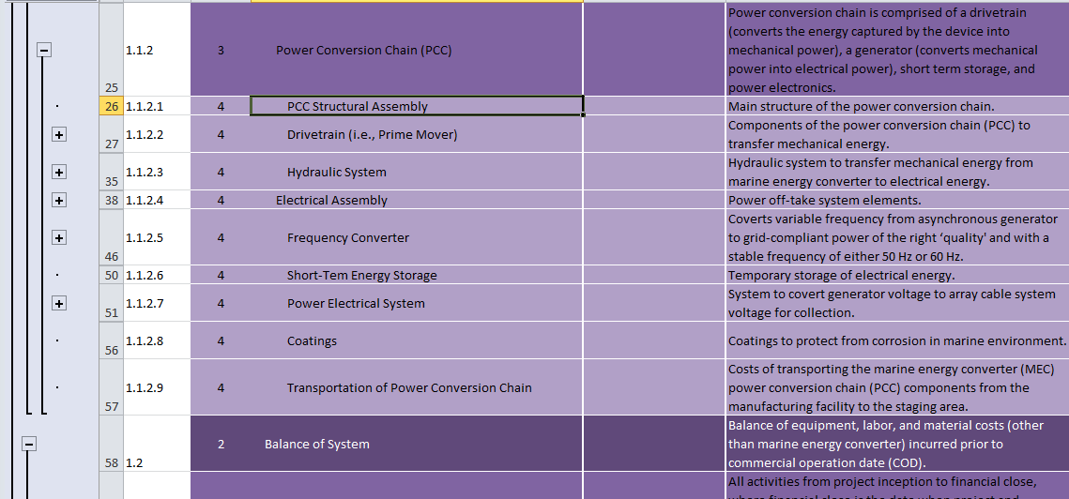
Adding Additional Categories – RM6
There is no dropdown for PCC structural assembly
Outline

Slide 37
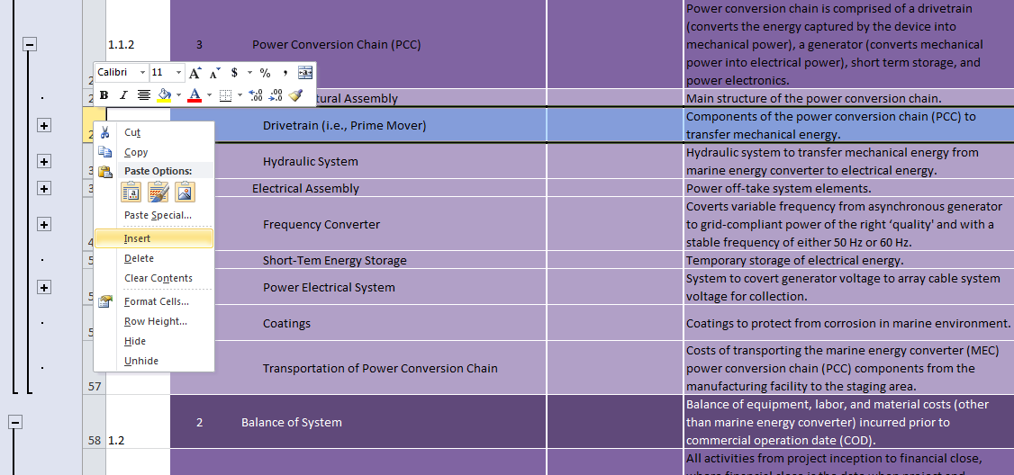
Adding Additional Categories – RM6
Right click the row number directly below the desired category, and insert as many rows as necessary
Outline

Slide 38
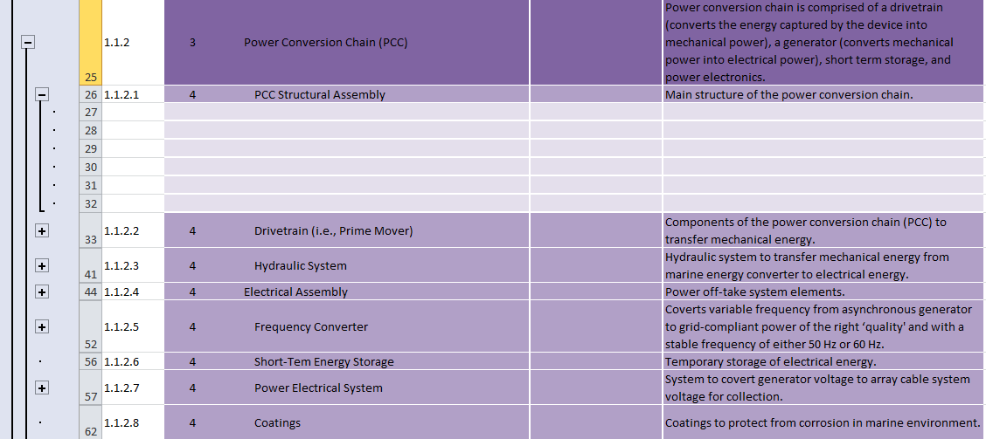
Adding Additional Categories – RM6
In this case 6 rows were added and they were formatted to match the other level 5 categories.
Outline

Slide 39
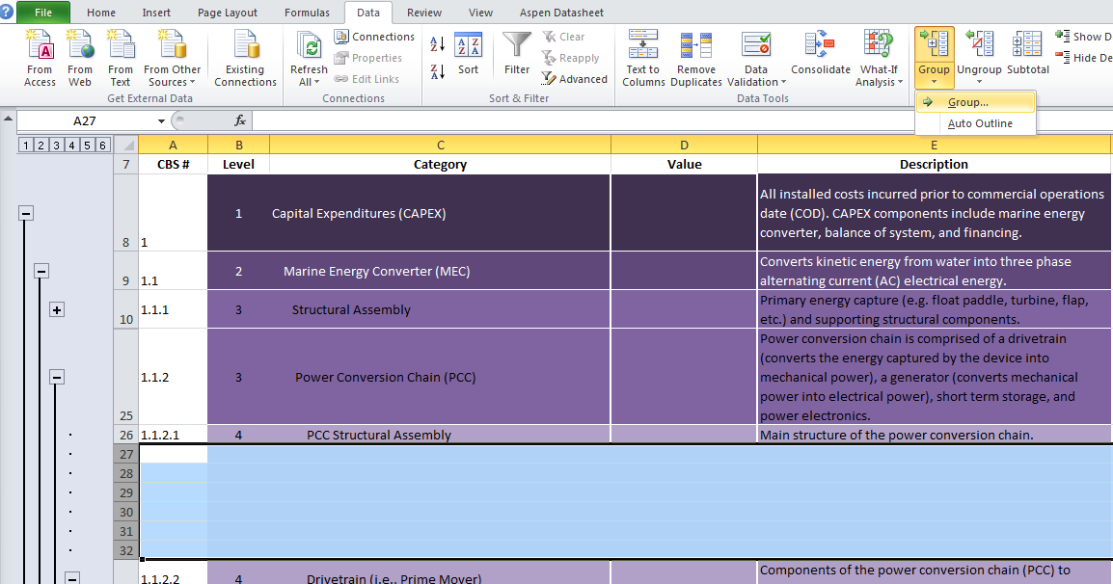
Adding Additional Categories – RM6
Highlight the desired rows and click Group under the Data Tab in Excel.
This will combine the rows into a group that is a subset of the PCC Structural Assembly category.
Outline

Slide 40
Adding Additional Categories – RM6
1.1.2 | 3 | Power Conversion Chain (PCC) |  | Power conversion chain is comprised of a drivetrain (converts the energy captured by the device into mechanical power), a generator (converts mechanical power into electrical power), short term storage, and power electronics.
1.1.2.1 | 4 | PCC Structural Assembly | $1,562,246 | Main structure of the power conversion chain.
1.1.2.1.1 | 5 | Fabricated Components | $1,456,157 | Fabricated Wells turbine components
1.1.2.1.2 | 5 | Ducting | $5,616 | Wells turbine Ducting
1.1.2.1.3 | 5 | Rotor Blades | $55,018 | Wells turbine rotor blades
1.1.2.1.4 | 5 | Bearings | $32,055 | Wells turbine bearings
1.1.2.1.5 | 5 | Couplings | $1,400 | Wells turbine to generator coupling
1.1.2.1.6 | 5 | Mechanical Face Seal | $12,000 | Generator face seal
1.1.2.2 | 4 | Drivetrain (i.e., Prime Mover) |  | Components of the power conversion chain (PCC) to transfer mechanical energy.
1.1.2.3 | 4 | Hydraulic System |  | Hydraulic system to transfer mechanical energy from marine energy converter to electrical energy.
1.1.2.4 | 4 | Electrical Assembly |  | Power off-take system elements.
Finally fill out the new categories as done before.
Outline

Slide 41
Filling out the SCBS – RM6 Example
Follow the same procedure for both Capital Expenditures and Operating Expenditures
It is expected that not every project will have the same level of detail
Fill out greatest detail available.
Declare where there are any assumptions and/or uncertainties.
Outline

Slide 42
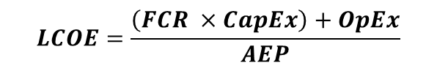
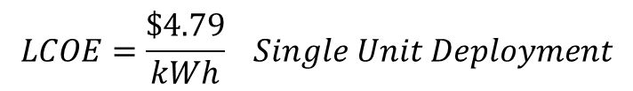
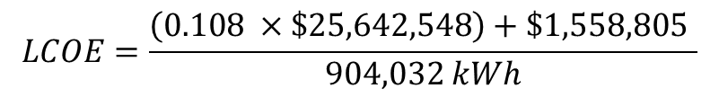
Final LCOE Calculation
Once all energy calculations and cost information is finished the values are input into the LCOE equation.
$$LCOE=\frac{\left(FCR ×CapEx\right)+OpEx}{AEP}$$
For the RM6 example, the calculation is as follows
$$LCOE=\frac{\left(0.108 ×\$25,642,548\right)+\$1,558,805 }{904,032 kWh}$$
$$LCOE=\frac{\$4.79}{kWh} Single Unit Deployment$$
Outline

Slide 43
Wave Checklist
Full Set of Requirements listed in the MHK LCOE Guidance Document
AEP
Device and array time domain performance model based on prescribed reference location (simulation results and code).
Mechanical Power matrix
Electrical Power Matrix
Itemized Losses between Mechanical Power and Power Capture Matrices, in matrix form if available
Documentation addressing additional modeling and design parameters (e.g. damping coefficients, mooring configuration, etc.)
Documentation addressing any assumptions regarding losses due to directionality, shallow water, or other device specific variables.
Assumptions relating to device survival modes
Additional design resource simulation runs (if applicable)
Capital Expenditures
CapEx costs at minimum of level 3
CapEx costs up to level 5 where applicable
All assumptions and uncertainties documented
Operational Expenditures
OpEx costs at minimum of level 3
OpEx costs up to level 5 where applicable
All assumptions and uncertainties documented
Final LCOE Calculation at array scale
Outline

Slide 44
Current Checklist
Full Set of Requirements listed in the MHK LCOE Guidance Document
AEP
Net Electrical Power Output
Represented graphically and in tabular form as a “Power Curve” relationship between power output and average current speed at TEC hub height.
Mechanical power curve
Extracted power curve
Coefficient of Performance Cp curve
Accounts for both cut-in and cut-out water velocities
Additional design resource simulation runs (if applicable)
Capital Expenditures
CapEx costs at minimum of level 3
CapEx costs up to level 5 where applicable
All assumptions and uncertainties documented
Operational Expenditures
OpEx costs at minimum of level 3
OpEx costs up to level 5 where applicable
All assumptions and uncertainties documented
Final LCOE Calculation at array scale
Outline

Slide 45
Additional Resources (Web Links)
OpenEI - MHK LCOE Reporting Guidance Page
MHK LCOE Guidance Document
MHK Reference Resources
MHK System Cost Breakdown Structure
MHK content Models
Sandia National Laboratories - Reference Model Project Page
Outline

Slide 46
For Questions Contact:
Alison LaBonte - Alison.LaBonte@ee.doe.gov
Scott Jenne – Dale.Jenne@NREL.gov

